Slide 1
Data and Computer Communications
Chapter 18 – Internet Protocols
Eighth Edition
by William Stallings
Lecture slides by Lawrie Brown
Notes:
Lecture slides prepared by Dr Lawrie Brown (UNSW@ADFA) for “Data and Computer Communications”, 8/e, by William Stallings, Chapter 18 “Internet Protocols”.

Slide 2
Internet Protocols
The map of the London Underground, which can be seen inside every train, has been called a model of its kind, a work of art. It presents the underground network as a geometric grid. The tube lines do not, of course, lie at right angles to one another like the streets of Manhattan. Nor do they branch off at acute angles or form perfect oblongs.
—King Solomon's Carpet. Barbara Vine (Ruth Rendell)
Notes:
This quote is from the start of Stallings DCC8e 18. This chapter examines the Internet Protocol, the foundation on which all of the internet-based protocols and on which internetworking is based.

Slide 3
Protocol Functions
have a small set of functions that form basis of all protocols
  encapsulation
  fragmentation and reassembly
  connection control
  ordered delivery
  flow control
  error control
  addressing
  multiplexing
  transmission services
Notes:
Key functions typically performed by a protocol include encapsulation, fragmentation and reassembly, connection control, ordered delivery, flow control, error control, addressing, and multiplexing. Not all protocols have all functions. But there are many instances of the same type of function being present in protocols at different levels.

Slide 4
Encapsulation
data usually transferred in blocks
called Protocol Data Units (PDUs)
have three categories of control
  address
  error-detecting code
  protocol control
encapsulation is addition of control information to data
have many examples of PDU’s in previous chapters
  e.g. TFTP, HDLC, frame relay, ATM, AAL5, LLC, IEEE 802.3, IEEE 802.11
Notes:
For virtually all protocols, data are transferred in blocks, called protocol data units (PDUs). Each PDU contains not only data but also control information. Indeed, some PDUs consist solely of control information and no data. The control information falls into three general categories:
• Address: The address of the sender and/or receiver may be indicated.
• Error-detecting code: Some sort of frame check sequence is often included for error detection.
• Protocol control: Additional information is included to implement the protocol functions listed in the remainder of this section.
The addition of control information to data is referred to as encapsulation. Data are accepted or generated by an entity and encapsulated into a PDU containing that data plus control information. Typically, the control information is contained in a PDU header; some data link layer PDUs include a trailer as well. Numerous examples of PDUs appear in the preceding chapters.

Slide 5
Fragmentation and Reassembly
protocol exchanges data between two entities
lower-level protocols may need to break data up into smaller blocks, called fragmentation
for various reasons
  network only accepts blocks of a certain size
  more efficient error control & smaller retransmission units
  fairer access to shared facilities
  smaller buffers
disadvantages
  smaller buffers
  more interrupts & processing time
Notes:
A protocol is concerned with exchanging data between two entities. Whether the application entity sends data in messages or in a continuous stream, lower-level protocols typically organize the data into blocks, and may need to divide a block received from a higher layer into multiple blocks of some smaller bounded size. This process is called fragmentation. There are a number of motivations for fragmentation, depending on the context. Among the typical reasons for fragmentation:
communications network may only accept blocks of data up to a certain size
Error control may be more efficient with a smaller PDU size
More equitable access to shared transmission facilities, with shorter delay, can be provided
smaller PDU size may mean receiving entities can allocate smaller buffers
There are several disadvantages to fragmentation that argue for making PDUs as large as possible:
• smaller blocks have a greater percentage of overhead.
• Smaller blocks result in more interrupts.
• More time is spent processing smaller, more numerous PDUs.
All of these factors must be taken into account by the protocol designer in determining minimum and maximum PDU size. The counterpart of fragmentation is reassembly. Eventually, the segmented data must be reassembled into messages appropriate to the application level. If PDUs arrive out of order, the task is complicated.

Slide 6
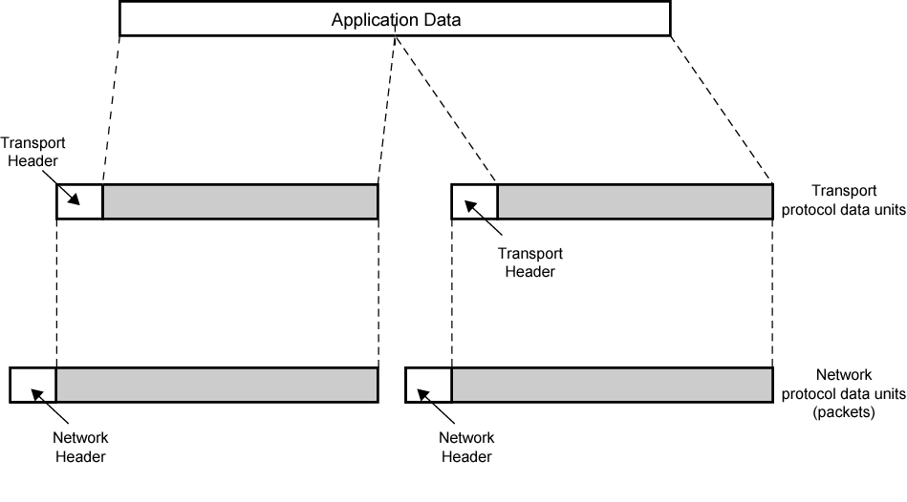
PDUS and Fragmentation
Notes:
Stallings DCC8e Figure 2.4 illustrates the general fragmentation process.

Slide 7
Connection Control
have connectionless data transfer
  where each PDU treated independently
and connection-oriented data transfer
  involves a logical association, or connection, established between entities
  preferred (even required) for lengthy data exchange
  or if protocol details are worked out dynamically
three phases occur for connection-oriented
  connection establishment
  data transfer
  connection termination
Notes:
Connectionless data transfer, for example the use of the datagram, is where an entity transmits data to another entity in such a way that each PDU is treated independently of all prior PDUs. Also have connection-oriented data transfer, such as the virtual circuit, which involves a logical association, or connection, established between the entities. Connection-oriented data transfer is to be preferred (even required) if stations anticipate a lengthy exchange of data and/or certain details of their protocol must be worked out dynamically. Three phases occur:
• Connection establishment
• Data transfer
• Connection termination
With more sophisticated protocols, there may also be connection interrupt and recovery phases to cope with errors and other sorts of interruptions.

Slide 8
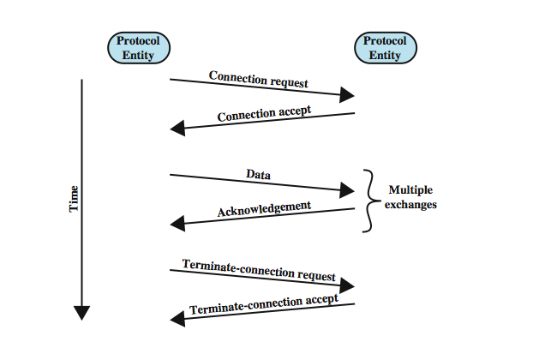
Phases of Connection Oriented Transfer
Notes:
During the connection establishment phase, two entities agree to exchange data.
Following connection establishment, the data transfer phase is entered. During this phase both data and control information (e.g., flow control, error control) are exchanged. Stallings DCC8e Figure 18.1 shows a situation in which all of the data flow in one direction, with acknowledgments returned in the other direction.
Finally, one side or the other wishes to terminate the connection and does so by sending a termination request. Alternatively, a central authority might forcibly terminate a connection.

Slide 9
Connection Establishment
entities agree to exchange data
typically, one station issues connection request
may involve central authority
receiving entity accepts or rejects (simple)
may include negotiation
syntax, semantics, and timing
both entities must use same protocol
may allow optional features
must be agreed
Notes:
During the connection establishment phase, two entities agree to exchange data. Typically, one station will issue a connection request (in connectionless fashion) to the other. A central authority may or may not be involved. In simpler protocols, the receiving entity either accepts or rejects the request and, in the former case, the connection is considered to be established. In more complex proposals, this phase includes a negotiation concerning the syntax, semantics, and timing of the protocol. Both entities must, of course, be using the same protocol. But the protocol may allow certain optional features and these must be agreed upon by means of negotiation. For example, the protocol may specify a PDU size of up to 8000 octets; one station may wish to restrict this to 1000 octets.

Slide 10
Data Transfer and Termination
both data and control information exchanged
data flow and acknowledgements may be in one or both directions
one side may send termination request
or central authority might terminate
Notes:
Following connection establishment, the data transfer phase is entered. During this phase both data and control information (e.g., flow control, error control) are exchanged. More typically, data and acknowledgments flow in both directions. Finally, one side or the other wishes to terminate the connection and does so by sending a termination request. Alternatively, a central authority might forcibly terminate a connection.

Slide 11
Sequencing
used by many, but not all, connection-oriented protocols
  e.g. HDLC, IEEE 802.11
connection-oriented protocols include some way of identifying connection
have PDUs numbered sequentially
each side tracks seq numbers in and out
to support three main functions
  ordered delivery
  llow control
  error control
Notes:
A key characteristic of many connection-oriented data transfer protocols is that sequencing is used (e.g., HDLC, IEEE 802.11). Sequencing is not found in all connection-oriented protocols. Examples include frame relay and ATM. However, all connection-oriented protocols include in the PDU format some way of identifying the connection, which may be a unique connection identifier or a combination of source and destination addresses.
Each side sequentially numbers the PDUs that it sends to the other side. Because each side remembers that it is engaged in a logical connection, it can keep track of both outgoing numbers, which it generates, and incoming numbers, which are generated by the other side. Indeed, one can essentially define a connection-oriented data transfer as one in which both sides number PDUs and keep track of both incoming and outgoing numbers. Sequencing supports three main functions: ordered deliver, flow control, and error control.

Slide 12
Ordered Delivery
risk PDUs may arrive out of order
require PDU order must be maintained
hence number PDUs sequentially
easy to reorder received PDUs
use finite sequence number field
  numbers repeat modulo maximum number
  max sequence number greater than max number of PDUs that could be outstanding
Notes:
If two communicating entities are in different hosts connected by a network, there is a risk that PDUs will not arrive in the order in which they were sent, because they may traverse different paths through the network. In connection-oriented protocols, it is generally required that PDU order be maintained. For example, if a file is transferred between two systems, we would like to be assured that the records of the received file are in the same order as those of the transmitted file, and not shuffled. If each PDU is given a unique number, and numbers are assigned sequentially, then it is a logically simple task for the receiving entity to reorder received PDUs on the basis of sequence number. A problem with this scheme is that, with a finite sequence number field, sequence numbers repeat (modulo some maximum number). Evidently, the maximum sequence number must be greater than the maximum number of PDUs that could be outstanding at any time. In fact, the maximum number may need to be twice the maximum number of PDUs that could be outstanding.

Slide 13
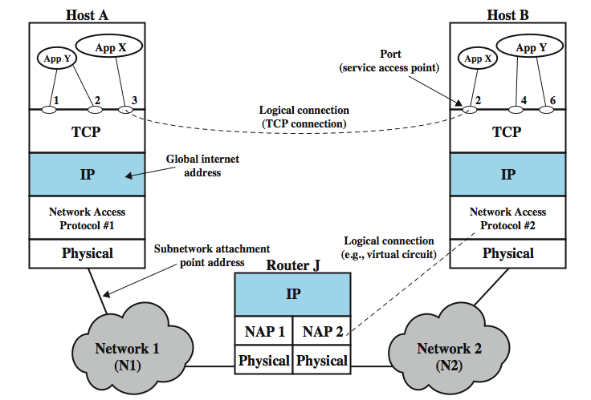
TCP/IP Concepts
Notes:
Stallings DCC8e Figure 18.2, which repeats Figure 2.1, illustrates a number of protocol concepts. Figure 18.2 shows several examples of connections. The logical connection between router J and host B is at the network level. For example, if network 2 is a frame relay network, then this logical connection would be a data link connection. At a higher level, many transport-level protocols, such as TCP, support logical connections between users of the transport service. Thus, TCP can maintain a connection between two ports on different systems.

Slide 14
Flow Control
receiving entity limits amount / rate of data sent
simplest protocol is stop-and-wait
more efficient protocols use concept of credit
  amount of data sent without acknowledgment
must be implemented in several protocols
  network traffic control
  buffer space
  application overflow
Notes:
Flow control is a function performed by a receiving entity to limit the amount or rate of data that is sent by a transmitting entity. The simplest form of flow control is a stop-and-wait procedure, in which each PDU must be acknowledged before the next can be sent. More efficient protocols involve some form of credit provided to the transmitter, which is the amount of data that can be sent without an acknowledgment. The HDLC sliding-window technique is an example of this mechanism.
Flow control is a good example of a function that must be implemented in several protocols. Consider Stallings DCC8e Figure 18.2. The network will need to exercise flow control over host A via the network access protocol, to enforce network traffic control. At the same time, B's network access module has finite buffer space and needs to exercise flow control over A's transmission; it can do this via the transport protocol. Finally, even though B's network access module can control its data flow, B's application may be vulnerable to overflow. For example, the application could be hung up waiting for disk access. Thus, flow control is also needed over the application-oriented protocol.

Slide 15
Error Control
to guard against loss or damage
implemented as separate error detection and retransmission functions
  sender inserts error-detecting code in PDU
  receiver checks code on incoming PDU
  if error, discard
  if transmitter doesn’t get acknowledgment in reasonable time, retransmit
can use an error-correction code
  enables receiver to detect and possibly correct errors
performed at various protocol layers
Notes:
Error control techniques are needed to guard against loss or damage of data and control information. Typically, error control is implemented as two separate functions: error detection and retransmission. To achieve error detection, the sender inserts an error-detecting code in the transmitted PDU, which is a function of the other bits in the PDU. The receiver checks the value of the code on the incoming PDU. If an error is detected the receiver discards the PDU. Upon failing to receive an acknowledgment to the PDU in a reasonable time, the sender retransmits the PDU. Some protocols also employ an error-correction code, which enables the receiver not only to detect errors but, in some cases, to correct them.
As with flow control, error control is a function that must be performed at various layers of protocol. Consider again Figure 18.2. The network access protocol should include error control to assure that data are successfully exchanged between station and network. However, a packet of data may be lost inside the network, and the transport protocol should be able to recover from this loss.

Slide 16
Addressing
addressing level
addressing scope
connection identifiers
addressing mode
Notes:
The concept of addressing in a communications architecture is a complex one and covers a number of issues, including:
• Addressing level
• Addressing scope
• Connection identifiers
• Addressing mode
During the discussion, we illustrate the concepts using Figure 18.2, which shows a configuration using the TCP/IP architecture. The concepts are essentially the same for the OSI architecture or any other communications architecture.

Slide 17
Addressing Level
level in architecture where entity is named
have a unique address for each intermediate and end system
usually a network-level address to route PDU
  e.g. IP address or internet address
  e.g. OSI - network service access point (NSAP)
at destination data must routed to some process
  e.g. TCP/IP port
  e.g. OSI service access point (SAP)
Notes:
Addressing level refers to the level in the communications architecture at which an entity is named. Typically, a unique address is associated with each end system (e.g., workstation or server) and each intermediate system (e.g., router) in a configuration. Such an address is, in general, a network-level address. In the case of the TCP/IP architecture, this is referred to as an IP address, or simply an internet address. In the case of the OSI architecture, this is referred to as a network service access point (NSAP). The network-level address is used to route a PDU through a network or networks to a system indicated by a network-level address in the PDU.
Once data arrive at a destination system, they must be routed to some process or application in the system. Typically, a system will support multiple applications and an application may support multiple users. Each application and, perhaps, each concurrent user of an application, is assigned a unique identifier, referred to as a port in the TCP/IP architecture and as a service access point (SAP) in the OSI architecture. Further, a file transfer application for example might support multiple simultaneous transfers, with each transfer dynamically assigned a unique port number or SAP. Figure 18.2 illustrates two levels of addressing within a system. This is typically the case for the TCP/IP architecture. However, there can be addressing at each level of an architecture. For example, a unique SAP can be assigned to each level of the OSI architecture.

Slide 18
Addressing Scope
global address which identifies unique system
  unambiguous
  synonyms permitted
  system may have more than one global address
  global applicability
  enables internet to route data between any two systems
need unique address for each interface on network
  MAC address on IEEE 802 network and ATM host address
  enables network to route data units through network
only relevant for network-level addresses
port or SAP above network level is unique within system
Notes:
Another issue that relates to the address of an end system or intermediate system is addressing scope. The internet address or NSAP address referred to previously is a global address. The key characteristics of a global address are:
• Global nonambiguity: A global address identifies a unique system. Synonyms are permitted. That is, a system may have more than one global address.
• Global applicability: It is possible at any global address to identify any other global address, in any system, by means of the global address of the other system.
Because a global address is unique and globally applicable, it enables an internet to route data from any system attached to any network to any other system attached to any other network. Figure 18.2 illustrates that another level of addressing may be required. Each network must maintain a unique address for each device interface on the network. Examples are a MAC address on an IEEE 802 network and an ATM host address. This address enables the network to route data units (e.g., MAC frames, ATM cells) through the network and deliver them to the intended attached system. We can refer to such an address as a network attachment point address. The issue of addressing scope is generally only relevant for network-level addresses. A port or SAP above the network level is unique within a given system but need not be globally unique. For example, in Figure 18.2, there can be a port 1 in system A and a port 1 in system B. The full designation of these two ports could be expressed as A.1 and B.1, which are unique designations.

Slide 19
Connection Identifiers
is used by both entities for future transmissions
advantages:
  reduced overhead since smaller
  routing using a fixed route tagged by connection ID
  multiplexing of multiple connections
  use of state information
Notes:
The concept of connection identifiers comes into play when we consider connection-oriented data transfer (e.g., virtual circuit) rather than connectionless data transfer (e.g., datagram). For connectionless data transfer, a global identifier is used with each data transmission. For connection-oriented transfer, it is sometimes desirable to use only a connection identifier during the data transfer phase. When the recipient accepts the connection, a connection identifier (usually a number) is provided and is used by both entities for future transmissions. The use of a connection identifier has several advantages:
• Reduced overhead: Connection identifiers are generally shorter than global identifiers. For example, in the frame relay protocol (discussed in Chapter 10), connection request packets contain both source and destination address fields. After a logical connection, called a data link connection, is established, data frames contain a data link connection identifier (DLCI) of 10, 16, or 23 bits.
• Routing: In setting up a connection, a fixed route may be defined. The connection identifier serves to identify the route to intermediate systems, such as packet-switching nodes, for handling future PDUs.
• Multiplexing: We address this function in more general terms later. Here we note that an entity may wish to enjoy more than one connection simultaneously. Thus, incoming PDUs must be identified by connection identifier.
• Use of state information: Once a connection is established, the end systems can maintain state information relating to the connection. This enables such functions as flow control and error control using sequence numbers.

Slide 20
Addressing Mode
address usually refers to single system
  individual or unicast address
can refer to more than one system for
  multiple simultaneous recipients for data
  broadcast for all entities within domain
  multicast for specific subset of entities
Notes:
Another addressing concept is that of addressing mode. Most commonly, an address refers to a single system or port; in this case it is referred to as an individual or unicast address. It is also possible for an address to refer to more than one entity or port. Such an address identifies multiple simultaneous recipients for data. For example, a user might wish to send a memo to a number of individuals. The network control center may wish to notify all users that the network is going down. An address for multiple recipients may be broadcast, intended for all entities within a domain, or multicast, intended for a specific subset of entities. Stallings DCC8e Table 18.1 illustrates some possibilities.

Slide 21
Multiplexing
multiple connections into single system
  e.g. frame relay, can have multiple data link connections terminating in single end system
  e.g. multiple TCP connections to given system
upward multiplexing
  have multiple higher level connections over a single lower level connection
downward multiplexing
  have single higher level connection built on multiple lower level connections
Notes:
Related to the concept of addressing is that of multiplexing. One form of multiplexing is supported by means of multiple connections into a single system. For example, with frame relay, there can be multiple data link connections terminating in a single end system. Multiplexing can also be accomplished via port names, which also permit multiple simultaneous connections. For example, there can be multiple TCP connections terminating in a given system, each connection supporting a different pair of ports.
Multiplexing is used in another context as well, namely the mapping of connections from one level to another. Consider again Figure 18.2. Network 1 might provide a connection-oriented service. For each process-to-process connection established at the next higher level, a data link connection could be created at the network access level. This is a one-to-one relationship, but need not be so. Multiplexing can be used in one of two directions. Upward multiplexing, or inward multiplexing, occurs when multiple higher-level connections are multiplexed on, or share, a single lower-level connection. This may be needed to make more efficient use of the lower-level service or to provide several higher-level connections in an environment where only a single lower-level connection exists. Downward multiplexing, or splitting, means that a single higher-level connection is built on top of multiple lower-level connections, the traffic on the higher connection being divided among the various lower connections. This technique may be used to provide reliability, performance, or efficiency.

Slide 22
Transmission Services
may have additional services to entities:
  priority on connection basis or message basis
  quality of service
    e.g. minimum throughput or maximum delay threshold
  security mechanisms, restricting access
these depend on underlying transmission system and lower-level entities
Notes:
A protocol may provide a variety of additional services to the entities that use it. We mention here three common examples:
• Priority: Certain messages, such as control messages, may need to get through to the destination entity with minimum delay. An example would be a terminate-connection request. Thus, priority could be assigned on a message basis. Additionally, priority could be assigned on a connection basis.
• Quality of service: Certain classes of data may require a minimum throughput or a maximum delay threshold.
• Security: Security mechanisms, restricting access, may be invoked.
All of these services depend on the underlying transmission system and any intervening lower-level entities. If it is possible for these services to be provided from below, the protocol can be used by the two entities to exercise those services.

Slide 23
Internetworking Terms
communications Network
internet
the Internet
intranet
End System (ES)
Intermediate System (IS)
bridge
router
Notes:
Stallings DCC8e Table 18.2 lists some commonly used terms relating to the interconnection of networks, or internetworking.
Communication Network - A facility that provides a data transfer service among devices attached to the network.
Internet - collection of networks interconnected by bridges and/or routers.
Intranet - An internet used by a single organization that provides the key Internet applications, especially the World Wide Web. An intranet operates within the organization for internal purposes and can exist as an isolated, self-contained internet, or may have links to the Internet.
Subnetwork - Refers to a constituent network of an internet. End System (ES) - A device attached to one of the networks of an internet that is used to support end-user applications or services.
Intermediate System (IS) - A device used to connect two networks and permit communication between end systems attached to different networks.
Bridge - An IS used to connect two LANs that use similar LAN protocols. The bridge acts as an address filter, picking up packets from one LAN that are intended for a destination on another LAN and passing those packets on. The bridge operates at layer 2 of the OSI model.
Router - An IS used to connect two networks that may or may not be similar. The router employs an internet protocol present in each router and each end system of the network. The router operates at layer 3 of the OSI model.

Slide 24
Requirements of Internetworking
link between networks
routing and delivery of data between processes on different networks
accounting services and status info
independent of network architectures
Notes:
The overall requirements for an internetworking facility are as follows (we refer to Stallings DCC8e Figure 18.2 as an example throughout):
1. Provide a link between networks. At minimum, a physical and link control connection is needed. (Router J has physical links to N1 and N2, and on each link there is a data link protocol.)
2. Provide for the routing and delivery of data between processes on different networks. (Application X on host A exchanges data with application X on host B.)
3. Provide an accounting service that keeps track of the use of the various networks and routers and maintains status information.
4. Provide the services just listed in such a way as not to require modifications to the networking architecture of any of the constituent networks. This means that the internetworking facility must accommodate a number of differences among networks.

Slide 25
Network Architecture Features
addressing
packet size
access mechanism
timeouts
error recovery
status reporting
routing
user access control
connection based or connectionless
Notes:
Different addressing schemes: The networks may use different endpoint names and addresses and directory maintenance schemes. Some form of global network addressing must be provided, as well as a directory service.
Different maximum packet size: Packets from one network may have to be broken up into smaller pieces for another, called fragmentation.
Different network access mechanisms: The network access mechanism between station and network may be different for different networks.
Different timeouts: Internetwork timing procedures must allow successful transmission that avoids unnecessary retransmissions.
Error recovery: Network procedures may provide anything from no error recovery up to reliable end-to-end (within the network) service.
Status reporting: Different networks report status / performance differently
Routing techniques: Intranetwork routing may depend on fault detection and congestion control techniques peculiar to each network.
User access control: Each network will have its own user access control technique (authorization for use of the network). These must be invoked by the internetwork facility as needed.
Connection, connectionless: Individual networks may provide connection-oriented (e.g., virtual circuit) or connectionless (datagram) service.

Slide 26
Architectural Approaches
connection oriented
  virtual circuit
connectionless
  datagram
  PDU’s routed independently from source ES to dest ES through routers and networks
  share common network layer protocol, e.g. IP
  below have network access on each node
Notes:
In virtually all implementation, internetworking involves connectionless operation at the level of the Internet Protocol. Whereas connection-oriented operation corresponds to the virtual circuit mechanism of a packet-switching network (Stallings DCC8e Figure 10.10), connectionless-mode operation corresponds to the datagram mechanism of a packet-switching network (Stallings DCC8e Figure 10.9). Each network protocol data unit is treated independently and routed from source ES to destination ES through a series of routers and networks. For each data unit transmitted by A, A makes a decision as to which router should receive the data unit. The data unit hops across the internet from one router to the next until it reaches the destination network. At each router, a routing decision is made (independently for each data unit) concerning the next hop. Thus, different data units may travel different routes between source and destination ES.
All ESs and all routers share a common network-layer protocol known generically as the Internet Protocol. An Internet Protocol (IP) was initially developed for the DARPA internet project and published as RFC 791 and has become an Internet Standard. Below this Internet Protocol, a protocol is needed to access a particular network. Thus, there are typically two protocols operating in each ES and router at the network layer: an upper sublayer that provides the internetworking function, and a lower sublayer that provides network access.

Slide 27
Connectionless Internetworking
advantages
  flexibility
  robust
  no unnecessary overhead
unreliable
  not guaranteed delivery
  not guaranteed order of delivery
    packets can take different routes
  reliability is responsibility of next layer up (e.g. TCP)
Notes:
IP provides a connectionless, or datagram, service between end systems. There are a number of advantages to this approach:
• A connectionless internet facility is flexible. It can deal with a variety of networks, some of which are themselves connectionless. In essence, IP requires very little from the constituent networks.
• A connectionless internet service can be made highly robust. This is basically the same argument made for a datagram network service versus a virtual circuit service. For a further discussion, see Section 10.5.
• A connectionless internet service is best for connectionless transport protocols, because it does not impose unnecessary overhead.
Stallings DCC8e Figure 18.3 (next slide) depicts a typical example using IP, in which two LANs are interconnected by a frame relay WAN.
This service offered by IP is an unreliable one. That is, IP does not guarantee that all data will be delivered or that the data that are delivered will arrive in the proper order. It is the responsibility of the next higher layer (e.g., TCP) to recover from any errors that occur. This approach provides for a great deal of flexibility. With the Internet Protocol approach, each unit of data is passed from router to router in an attempt to get from source to destination. Because delivery is not guaranteed, there is no particular reliability requirement on any of the networks. Thus, the protocol will work with any combination of network types.

Slide 28
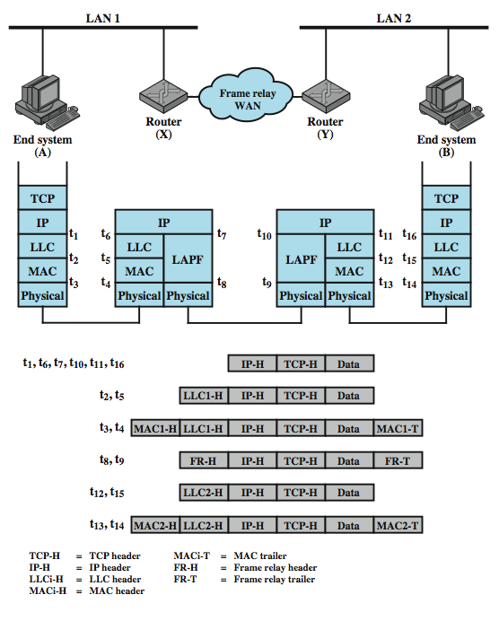
IP Operation
Notes:
Stallings DCC8e Figure 18.3 depicts a typical example using IP, in which two LANs are interconnected by a frame relay WAN. The figure depicts the operation of the Internet Protocol for data exchange between host A on one LAN (network 1) and host B on another LAN (network 2) through the WAN. The figure shows the protocol architecture and format of the data unit at each stage. The IP at A receives blocks of data to be sent to B from a higher layers of software in A (e.g., TCP or UDP). IP attaches a header (at time t₁) specifying, among other things, the global internet address of B. That address is logically in two parts: network identifier and end system identifier. The combination of IP header and upper-level data is called an Internet Protocol data unit (PDU), or simply a datagram. The datagram is then encapsulated with the LAN protocol (LLC header at t₂; MAC header and trailer at t₃).and sent to the router, which strips off the LAN fields to read the IP header (t₆). The router then encapsulates the datagram with the frame relay protocol fields (t₈) and transmits it across the WAN to another router. This router strips off the frame relay fields and recovers the datagram, which it then wraps in LAN fields appropriate to LAN 2 and sends it to B.

Slide 29
Design Issues
routing
datagram lifetime
fragmentation and re-assembly
error control
flow control
Notes:
With that brief sketch of the operation of an IP-controlled internet, we now examine the above design issues in greater detail.

Slide 30
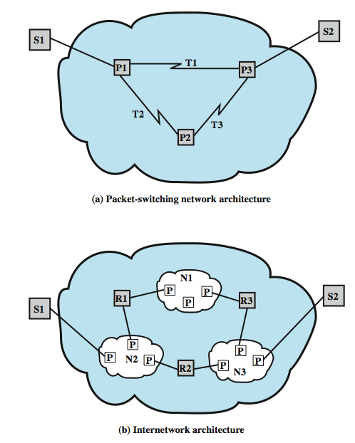
The Internet as a Network
Notes:
As we proceed with this discussion, note the many similarities with design issues and techniques relevant to packet-switching networks. To see the reason for this, consider Stallings DCC8e Figure 18.4, which compares an internet architecture with a packet-switching network architecture. The routers (R1, R2, R3) in the internet correspond to the packet-switching nodes (P1, P2, P3) in the network, and the networks (N1, N2, N3) in the internet correspond to the transmission links (T1, T2, T3) in the networks. The routers perform essentially the same functions as packet-switching nodes and use the intervening networks in a manner analogous to transmission links.

Slide 31
Routing
ES / routers maintain routing tables
  indicate next router to which datagram is sent
  static
  dynamic
source routing
  source specifies route to be followed
  can be useful for security & priority
route recording
Notes:
For the purpose of routing, each end system and router maintains a routing table that lists, for each possible destination network, the next router to which the internet datagram should be sent.The routing table may be static or dynamic. A static table, however, could contain alternate routes if a particular router is unavailable. A dynamic table is more flexible in responding to both error and congestion conditions. In the Internet, for example, when a router goes down, all of its neighbors will send out a status report, allowing other routers and stations to update their routing tables. A similar scheme can be used to control congestion. Congestion control is particularly important because of the mismatch in capacity between local and wide area networks. Routing tables may also be used to support other internetworking services, such as security and priority.
Another routing technique is source routing. The source station specifies the route by including a sequential list of routers in the datagram. This, again, could be useful for security or priority requirements.
Finally, we mention a service related to routing: route recording. To record a route, each router appends its internet address to a list of addresses in the datagram. This feature is useful for testing and debugging purposes.

Slide 32
Datagram Lifetime
datagrams could loop indefinitely
  consumes resources
  transport protocol may need upper bound on lifetime of a datagram
can mark datagram with lifetime
  Time To Live field in IP
  when lifetime expires, datagram discarded
  simplest is hop count
  or time count
Notes:
If dynamic or alternate routing is used, the potential exists for a datagram to loop indefinitely through the internet. This is undesirable for two reasons. First, an endlessly circulating datagram consumes resources. Second, we will see in Chapter 20 that a transport protocol may depend on the existence of an upper bound on datagram lifetime. To avoid these problems, each datagram can be marked with a lifetime. Once the lifetime expires, the datagram is discarded.
A simple way to implement lifetime is to use a hop count. Each time that a datagram passes through a router, the count is decremented. Alternatively, the lifetime could be a true measure of time. This requires that the routers must somehow know how long it has been since the datagram or fragment last crossed a router, to know by how much to decrement the lifetime field. This would seem to require some global clocking mechanism. The advantage of using a true time measure is that it can be used in the reassembly algorithm, described next.

Slide 33
Fragmentation and
Re-assembly
may have different packet sizes
  on networks along path used by datagram
issue of when to re-assemble
  at destination
    packets get smaller as data traverses internet
  intermediate re-assembly
    need large buffers at routers
    buffers may fill with fragments
    all fragments must go through same router
Notes:
Individual networks within an internet may specify different maximum packet sizes. It would be inefficient and unwieldy to try to dictate uniform packet size across networks. Thus, routers may need to fragment incoming datagrams into smaller pieces, called segments or fragments, before transmitting on to the next network.
If datagrams can be fragmented (perhaps more than once) in the course of their travels, the question arises as to where they should be reassembled. The easiest solution is to have reassembly performed at the destination only. The principal disadvantage of this approach is that fragments can only get smaller as data move through the internet. This may impair the efficiency of some networks. However, if intermediate router reassembly is allowed, the following disadvantages result:
1. Large buffers are required at routers, and there is the risk that all of the buffer space will be used up storing partial datagrams.
2. All fragments of a datagram must pass through the same router. This inhibits the use of dynamic routing.

Slide 34
IP Fragmentation
IP re-assembles at destination only
uses fields in header
  Data Unit Identifier (ID)
    identifies end system originated datagram
  Data length
    length of user data in octets
  Offset
    position of fragment of user data in original datagram
    in multiples of 64 bits (8 octets)
  More flag
    indicates that this is not the last fragment
Notes:
In IP, datagram fragments are reassembled at the destination end system. The IP fragmentation technique uses the following information in the IP header: Data Unit Identifier (ID), Data Length, Offset, & More Flag.
The ID is a means of uniquely identifying an end-system-originated datagram. In IP, it consists of the source and destination addresses, a number that corresponds to the protocol layer that generated the data (e.g., TCP), and an identification supplied by that protocol layer. The Data Length is the length of the user data field in octets, and the Offset is the position of a fragment of user data in the data field of the original datagram, in multiples of 64 bits.
The source end system creates a datagram with a Data Length equal to the entire length of the data field, with Offset = 0, and a More Flag set to 0 (false). To fragment a long datagram into two pieces, an IP module in a router performs the following tasks:
Create two new datagrams and copy the header fields of the incoming datagram into both.
Divide the incoming user data field into two portions along a 64-bit boundary placing one portion in each new datagram
Set the Data Length of the first new datagram to the length of the inserted data, and set More Flag to 1 (true). The Offset field is unchanged.
Set the Data Length of the second new datagram to the length of the inserted data, and add the length of the first data portion divided by 8 to the Offset field. The More Flag remains the same.

Slide 35
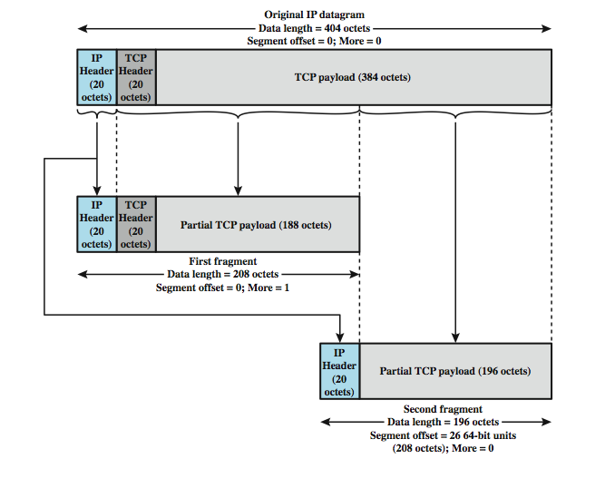
Fragmentation Example
Notes:
Stallings DCC8e Figure 18.5 gives an example in which two fragments are created from an original IP datagram. The procedure is easily generalized to an n-way split. In this example, the payload of the original IP datagram is a TCP segment, consisting of a TCP header and application data. The IP header from the original datagram is used in both fragments, with the appropriate changes to the fragmentation-related fields. Note that the first fragment contains the TCP header; this header is not replicated in the second fragment, because all of the IP payload, including the TCP header is transparent to IP. That is, IP is not concerned with the contents of the payload of the datagram. To reassemble a datagram, there must be sufficient buffer space at the reassembly point. As fragments with the same ID arrive, their data fields are inserted in the proper position in the buffer until the entire data field is reassembled, which is achieved when a contiguous set of data exists starting with an Offset of zero and ending with data from a fragment with a false More Flag.

Slide 36
Dealing with Failure
re-assembly may fail if some fragments get lost
need to detect failure
re-assembly time out
  assigned to first fragment to arrive
  if timeout expires before all fragments arrive, discard partial data
use packet lifetime (time to live in IP)
  if time to live runs out, kill partial data
Notes:
One eventuality that must be dealt with is that one or more of the fragments may not get through: the IP service does not guarantee delivery. Some method is needed to decide when to abandon a reassembly effort to free up buffer space. Two approaches are commonly used. First, assign a reassembly lifetime to the first fragment to arrive. This is a local, real-time clock assigned by the reassembly function and decremented while the fragments of the original datagram are being buffered. If the time expires prior to complete reassembly, the received fragments are discarded. A second approach is to make use of the datagram lifetime, which is part of the header of each incoming fragment. The lifetime field continues to be decremented by the reassembly function; as with the first approach, if the lifetime expires prior to complete reassembly, the received fragments are discarded.

Slide 37
Error Control
no guaranteed delivery
router should attempt to inform source if packet discarded
source may modify transmission strategy
may inform high layer protocol
need datagram identification
see ICMP in next section
Notes:
The internetwork facility does not guarantee successful delivery of every datagram. When a datagram is discarded by a router, the router should attempt to return some information to the source, if possible. The source Internet Protocol entity may use this information to modify its transmission strategy and may notify higher layers. To report that a specific datagram has been discarded, some means of datagram identification is needed. Such identification is discussed in the next section. Datagrams may be discarded for a number of reasons, including lifetime expiration, congestion, and FCS error. In the latter case, notification is not possible because the source address field may have been damaged.

Slide 38
Flow Control
allows routers and/or stations to limit rate of incoming data
limited in connectionless systems
send flow control packets to request reduced flow
see ICMP in next section
Notes:
Internet flow control allows routers and/or receiving stations to limit the rate at which they receive data. For the connectionless type of service we are describing, flow control mechanisms are limited. The best approach would seem to be to send flow control packets, requesting reduced data flow, to other routers and source stations. We will see one example of this with ICMP, discussed in the next section.

Slide 39
Internet Protocol (IP) v4
IP version 4
defined in RFC 791
part of TCP/IP suite
two parts
  specification of interface with a higher layer
    e.g. TCP
  specification of actual protocol format and mechanisms
will (eventually) be replaced by IPv6
Notes:
In this section, we look at version 4 of IP, officially defined in RFC 791. Although it is intended that IPv4 will ultimately be replaced by IPv6, it is currently the standard IP used in TCP/IP networks. The Internet Protocol (IP) is part of the TCP/IP suite and is the most widely used internetworking protocol. As with any protocol standard, IP is specified in two parts (see Stallings DCC8e Figure 2.9):
• The interface with a higher layer (e.g., TCP), specifying the services that IP provides
• The actual protocol format and mechanisms
In this section, we examine first IP services and then the protocol. This is followed by a discussion of IP address formats. Finally, the Internet Control Message Protocol (ICMP), which is an integral part of IP, is described.

Slide 40
IP Services
Primitives
  functions to be performed
  form of primitive implementation dependent
  Send - request transmission of data unit
  Deliver - notify user of arrival of data unit
Parameters
  used to pass data and control info
Notes:
The services to be provided across adjacent protocol layers (e.g., between IP and TCP) are expressed in terms of primitives and parameters. A primitive specifies the function to be performed, and the parameters are used to pass data and control information. The actual form of a primitive is implementation dependent. An example is a procedure call.
IP provides two service primitives at the interface to the next higher layer. The Send primitive is used to request transmission of a data unit. The Deliver primitive is used by IP to notify a user of the arrival of a data unit.

Slide 41
IP Parameters
source & destination addresses
protocol
type of Service
identification
don’t fragment indicator
time to live
data length
option data
user data
Notes:
The parameters associated with the two primitives are:
• Source address: Internetwork address of sending IP entity.
• Destination address: Internetwork address of destination IP entity.
• Protocol: Recipient protocol entity (an IP user, such as TCP).
• Type of service indicators: Used to specify the treatment of the data unit in its transmission through component networks.
• Identification: Used in combination with the source and destination addresses and user protocol to identify the data unit uniquely. This parameter is needed for reassembly and error reporting.
• Don't fragment identifier: Indicates whether IP can fragment data to accomplish delivery.
• Time to live: Measured in seconds.
• Data length: Length of data being transmitted.
• Option data: Options requested by the IP user.
• Data: User data to be transmitted.

Slide 42
IP Options
security
source routing
route recording
stream identification
timestamping
Notes:
The options parameter allows for future extensibility and for inclusion of parameters that are usually not invoked. The currently defined options are:
• Security: Allows a security label to be attached to a datagram.
• Source routing: A sequenced list of router addresses that specifies the route to be followed. Routing may be strict (only identified routers may be visited) or loose (other intermediate routers may be visited).
• Route recording: A field is allocated to record the sequence of routers visited by the datagram.
• Stream identification: Names reserved resources used for stream service. This service provides special handling for volatile periodic traffic (e.g., voice).
• Timestamping: The source IP entity and some or all intermediate routers add a timestamp (precision to milliseconds) to the data unit as it goes by.

Slide 43
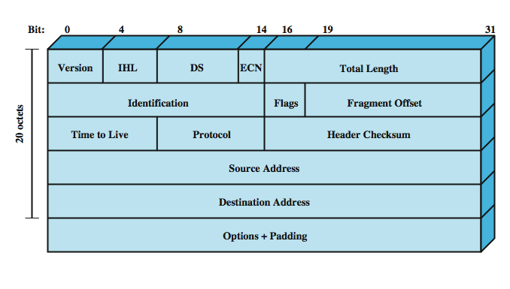
IPv4 Header
Notes:
The protocol between IP entities is best described with reference to the IP datagram format, shown in Figure Stallings DCC8e 18.6. The fields are discussed on the next few slides.

Slide 44
Header Fields (1)
Version
  currently 4
  IP v6 - see later
Internet header length
  in 32 bit words
  including options
DS/ECN (was type of service)
total length
  of datagram, in octets
Notes:
Version (4 bits): Indicates version number, to allow evolution of the protocol; the value is 4.
Internet Header Length (IHL) (4 bits): Length of header in 32-bit words. The minimum value is five, for a minimum header length of 20 octets.
DS/ECN (8 bits): Prior to the introduction of differentiated services, this field was referred to as the Type of Service field and specified reliability, precedence, delay, and throughput parameters. This interpretation has now been superseded. The first six bits of this field are now referred to as the DS (differentiated services) field, discussed in Chapter 19. The remaining 2 bits are reserved for an ECN (explicit congestion notification) field, currently in the process of standardization. The ECN field provides for explicit signaling of congestion in a manner similar to that discussed for frame relay (Section 13.5).
Total Length (16 bits): Total datagram length, including header plus data, in octets.

Slide 45
Header Fields (2)
Identification
  sequence number
  identify datagram uniquely with addresses / protocol
Flags
  More bit
  Don’t fragment
Fragmentation offset
Time to live
Protocol
  Next higher layer to receive data field at destination
Notes:
Identification (16 bits): A sequence number that, together with the source address, destination address, and user protocol, is intended to identify a datagram uniquely.
Flags (3 bits): Only two of the bits are currently defined. The More bit is used for fragmentation and reassembly, as previously explained. The Don't Fragment bit prohibits fragmentation when set. This bit may be useful if it is known that the destination does not have the capability to reassemble fragments. However, if this bit is set, the datagram will be discarded if it exceeds the maximum size of an en route network.
Fragment Offset (13 bits): Indicates where in the original datagram this fragment belongs, measured in 64-bit units. This implies that fragments other than the last fragment must contain a data field that is a multiple of 64 bits in length.
Time to Live (8 bits): Specifies how long, in seconds, a datagram is allowed to remain in the internet. Every router that processes a datagram must decrease the TTL by at least one, so the TTL is similar to a hop count.
Protocol (8 bits): Indicates the next higher level protocol that is to receive the data field at the destination; thus, this field identifies the type of the next header in the packet after the IP header. Example values are TCP = 6; UDP = 17; ICMP = 1.

Slide 46
Header Fields (3)
Header checksum
  reverified and recomputed at each router
  16 bit ones complement sum of all 16 bit words in header
  set to zero during calculation
Source address
Destination address
Options
Padding
  to fill to multiple of 32 bits long
Notes:
• Header Checksum (16 bits): An error-detecting code applied to the header only. Because some header fields may change during transit (e.g., time to live, fragmentation-related fields), this is reverified and recomputed at each router. The checksum is formed by taking the ones complement of the 16-bit ones complement addition of all 16-bit words in the header. For purposes of computation, the checksum field is itself initialized to a value of zero.
• Source Address (32 bits): Coded to allow a variable allocation of bits to specify the network and the end system attached to the specified network, as discussed subsequently.
• Destination Address (32 bits): Same characteristics as source address.
• Options (variable): Encodes the options requested by the sending user.
• Padding (variable): Used to ensure that the datagram header is a multiple of 32 bits in length.

Slide 47
Data Field
carries user data from next layer up
integer multiple of 8 bits long (octet)
max length of datagram (header plus data) is 65,535 octets
Notes:
• Data (variable): The data field must be an integer multiple of 8 bits in length. The maximum length of the datagram (data field plus header) is 65,535 octets.

Slide 48
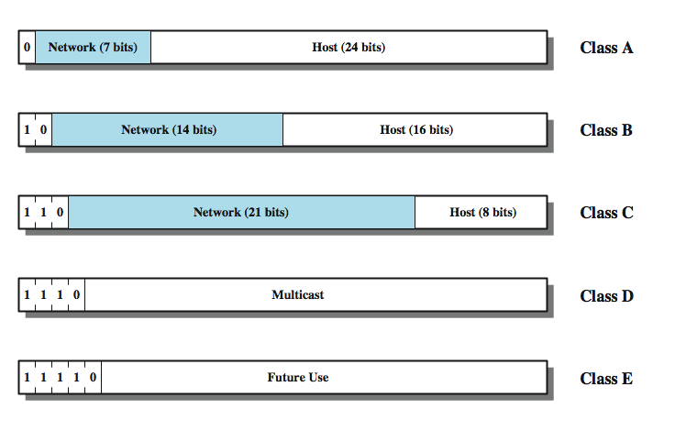
IPv4 Address Formats
Notes:
The source and destination address fields in the IP header each contain a 32-bit global internet address, generally consisting of a network identifier and a host identifier. The address is coded to allow a variable allocation of bits to specify network and host, as depicted in Figure 18.7. This encoding provides flexibility in assigning addresses to hosts and allows a mix of network sizes on an internet. The three principal network classes are best suited to the following conditions:
• Class A: Few networks, each with many hosts
• Class B: Medium number of networks, each with a medium number of hosts
• Class C: Many networks, each with a few hosts
In a particular environment, it may be best to use addresses all from one class. For example, a corporate internetwork that consist of a large number of departmental local area networks may need to use Class C addresses exclusively. However, the format of the addresses is such that it is possible to mix all three classes of addresses on the same internetwork; this is what is done in the case of the Internet itself. A mixture of classes is appropriate for an internetwork consisting of a few large networks, many small networks, plus some medium-sized networks.

Slide 49
IP Addresses - Class A
start with binary 0
all 0 reserved
01111111 (127) reserved for loopback
range 1.x.x.x to 126.x.x.x
all allocated
Notes:
Note that all Class A network addresses begin with a binary 0. Network addresses with a first octet of 0 (binary 00000000) and 127 (binary 01111111) are reserved, so there are 126 potential Class A network numbers, which have a first dotted decimal number in the range 1 to 126.

Slide 50
IP Addresses - Class B
start with binary 10
range 128.x.x.x to 191.x.x.x
second octet also included in network address
2¹⁴ = 16,384 class B addresses
all allocated
Notes:
Class B network addresses begin with a binary 10, so that the range of the first decimal number in a Class B address is 128 to 191(binary 10000000 to 10111111). The second octet is also part of the Class B address, so that there are 2¹⁴ = 16,384 Class B addresses.

Slide 51
IP Addresses - Class C
start with binary 110
range 192.x.x.x to 223.x.x.x
second and third octet also part of network address
2²¹ = 2,097,152 addresses
nearly all allocated
  see IPv6
Notes:
For Class C addresses, the first decimal number ranges from 192 to 223 (11000000 to 11011111). The total number of Class C addresses is 2²¹ = 2,097,152.

Slide 52
Subnets and Subnet Masks
allows arbitrary complexity of internetworked LANs within organization
insulate overall internet from growth of network numbers and routing complexity
site looks to rest of internet like single network
each LAN assigned subnet number
host portion of address partitioned into subnet number and host number
local routers route within subnetted network
subnet mask indicates which bits are subnet number and which are host number
Notes:
The concept of subnet was introduced to address the following requirement. Consider an internet that includes one or more WANs and a number of sites, each of which has a number of LANs. We would like to allow arbitrary complexity of interconnected LAN structures within an organization, while insulating the overall internet against explosive growth in network numbers and routing complexity. One approach to this problem is to assign a single network number to all of the LANs at a site. From the point of view of the rest of the internet, there is a single network at that site, which simplifies addressing and routing. To allow the routers within the site to function properly, each LAN is assigned a subnet number. The host portion of the internet address is partitioned into a subnet number and a host number to accommodate this new level of addressing.
Within the subnetted network, the local routers must route on the basis of an extended network number consisting of the network portion of the IP address and the subnet number. The bit positions containing this extended network number are indicated by the address mask. The use of the address mask allows the host to determine whether an outgoing datagram is destined for a host on the same LAN (send directly) or another LAN (send datagram to router). It is assumed that some other means (e.g., manual configuration) are used to create address masks and make them known to the local routers.

Slide 53
Subnet Mask Calculation
Notes:
Stallings DCC8e Table 18.3a shows the calculations involved in the use of a subnet mask. Note that the effect of the subnet mask is to erase the portion of the host field that refers to an actual host on a subnet. What remains is the network number and the subnet number.

Slide 54
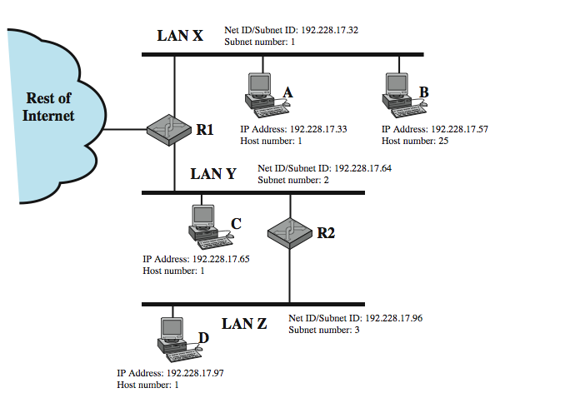
Routing Using Subnets
Notes:
Stallings DCC8e Figure 18.8 shows an example of the use of subnetting. The figure shows a local complex consisting of three LANs and two routers. To the rest of the internet, this complex is a single network with a Class C address of the form 192.228.17.x, where the leftmost three octets are the network number and the rightmost octet contains a host number x. Both routers R1 and R2 are configured with a subnet mask with the value 255.255.255.224 (see Table 18.3a). For example, if a datagram with the destination address 192.228.17.57 arrives at R1 from either the rest of the internet or from LAN Y, R1 applies the subnet mask to determine that this address refers to subnet 1, which is LAN X, and so forwards the datagram to LAN X. Similarly, if a datagram with that destination address arrives at R2 from LAN Z, R2 applies the mask and then determines from its forwarding database that datagrams destined for subnet 1 should be forwarded to R1. Hosts must also employ a subnet mask to make routing decisions. The default subnet mask for a given class of addresses is a null mask, which yields the same network and host number as the non-subnetted address.

Slide 55
ICMP
Internet Control Message Protocol
RFC 792 (get it and study it)
transfer of (control) messages from routers and hosts to hosts
feedback about problems
  e.g. time to live expired
encapsulated in IP datagram
  hence not reliable
Notes:
The IP standard specifies that a compliant implementation must also implement ICMP (RFC 792). ICMP provides a means for transferring messages from routers and other hosts to a host. In essence, ICMP provides feedback about problems in the communication environment. Examples of its use are when a datagram cannot reach its destination, when the router does not have the buffering capacity to forward a datagram, and when the router can direct the station to send traffic on a shorter route. In most cases, an ICMP message is sent in response to a datagram, either by a router along the datagram's path or by the intended destination host.
Although ICMP is, in effect, at the same level as IP in the TCP/IP architecture, it is a user of IP. An ICMP message is constructed and then passed down to IP, which encapsulates the message with an IP header and then transmits the resulting datagram in the usual fashion. Because ICMP messages are transmitted in IP datagrams, their delivery is not guaranteed and their use cannot be considered reliable.

Slide 56
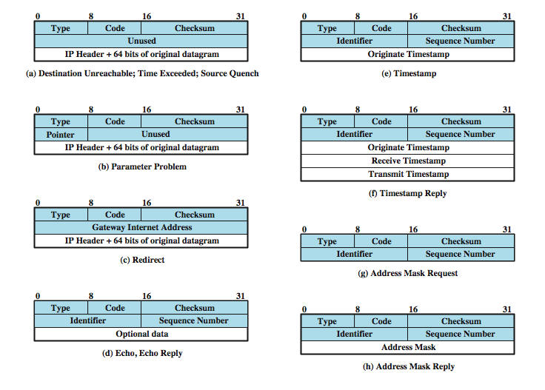
ICMP Message Formats
Notes:
Stallings DCC8e Figure 18.9 shows the format of the various ICMP message types. An ICMP message starts with a 64-bit header consisting of the following:
• Type (8 bits): Specifies the type of ICMP message.
• Code (8 bits): Used to specify parameters of the message that can be encoded in one or a few bits.
• Checksum (16 bits): Checksum of the entire ICMP message. This is the same checksum algorithm used for IP.
• Parameters (32 bits): Used to specify more lengthy parameters.
These fields are generally followed by additional information fields that further specify the content of the message. In those cases in which the ICMP message refers to a prior datagram, the information field includes the entire IP header plus the first 64 bits of the data field of the original datagram. This enables the source host to match the incoming ICMP message with the prior datagram.

Slide 57
Common ICMP Messages
destination unreachable
time exceeded
parameter problem
source quench
redirect
echo & echo reply
timestamp & timestamp reply
address mask request & reply
Notes:
The destination unreachable message covers a number of contingencies. A router may return this message if it does not know how to reach the destination network.
A router will return a time exceeded message if the lifetime of the datagram expires. A host will send this message if it cannot complete reassembly within a time limit.
A syntactic or semantic error in an IP header will cause a parameter problem message to be returned by a router or host.
The source quench message provides a rudimentary form of flow control. Either a router or a destination host may send this message to a source host, requesting that it reduce the rate at which it is sending traffic to the destination.
A router sends a redirect message to a host on a directly connected router to advise the host of a better route to a particular destination.
The echo and echo reply messages provide a mechanism for testing that communication is possible between entities. The recipient of an echo message is obligated to return the message in an echo reply message. The common “ping” utility uses these messages
The timestamp and timestamp reply messages provide a mechanism for sampling the delay characteristics of the internet.
The address mask request and address mask reply messages are useful in an environment that includes subnets, enabling a host to learn the address mask for the LAN to which it connects.

Slide 58
Address Resolution Protocol (ARP)
need MAC address to send to LAN host
  manual
  included in network address
  use central directory
  use address resolution protocol
ARP (RFC 826) provides dynamic IP to ethernet address mapping
  source broadcasts ARP request
  destination replies with ARP response
Notes:
To deliver an IP datagram to a destination host, a mapping must be made from the IP address to the subnetwork address for the last hop on the destination network. . If a datagram traverses one or more routers between source and destination hosts, then the mapping must be done in the final router, which is attached to the same subnetwork as the destination host. If a datagram is sent from one host to another on the same subnetwork, then the source host must do the mapping. For mapping from an IP address to a subnetwork address, a number of approaches are possible, including:
• Each system can maintain a local table of IP addresses and matching subnetwork addresses for possible correspondents.
• The subnetwork address can be a subset of the network portion of the IP address. But 32 bits IP addresses are not large enough.
• A centralized directory can be maintained on each subnetwork that contains the IP-subnet address mappings.
• An address resolution protocol can be used. This is a simpler approach than the use of a centralized directory and is well suited to LANs.
RFC 826 defines an Address Resolution Protocol (ARP), which allows dynamic distribution of the information needed to build tables to translate an IP address A into a 48-bit Ethernet address; the protocol can be used for any broadcast network. ARP exploits the broadcast property of a LAN; namely, that a transmission from any device on the network is received by all other devices on the network.

Slide 59
IP Versions
IP v 1-3 defined and replaced
IP v4 - current version
IP v5 - streams protocol
IP v6 - replacement for IP v4
  during development it was called IPng (IP Next Generation)
Notes:
The Internet Protocol (IP) has been the foundation of the Internet and virtually all multivendor private internetworks. This protocol is reaching the end of its useful life and a new protocol, known as IPv6 (IP version 6), has been defined to ultimately replace IP. The currently deployed version of IP is IP version 4; previous versions of IP (1 through 3) were successively defined and replaced to reach IPv4. Version 5 is the number assigned to the Stream Protocol, a connection-oriented internet-layer protocol. Hence the use of the label version 6.
In response to these needs, the Internet Engineering Task Force (IETF) issued a call for proposals for a next generation IP (IPng) in July of 1992. A number of proposals were received, and by 1994 the final design for IPng emerged.

Slide 60
Why Change IP?
Address space exhaustion
  two level addressing (network and host) wastes space
  network addresses used even if not connected
  growth of networks and the Internet
  extended use of TCP/IP
  single address per host
requirements for new types of service
Notes:
The driving motivation for the adoption of a new version of IP was the limitation imposed by the 32-bit address field in IPv4. With a 32-bit address field, it is possible in principle to assign 2³² different addresses, which is over 4 billion possible addresses. In the late 1980s it was perceived that there would be a problem, and this problem began to manifest itself in the early 1990s. Reasons for the inadequacy of 32-bit addresses include the following:
• The two-level structure of the IP address (network number, host number) is convenient but wasteful of the address space. Once a network number is assigned to a network, all of the host-number addresses for that network number are assigned to that network. The address space for that network may be sparsely used, but as far as the effective IP address space is concerned, if a network number is used, then all addresses within the network are used.
• The IP addressing model requires a unique network number be assigned to each IP network whether or not it is actually connected to the Internet.
• Networks are proliferating rapidly.
• Growth of TCP/IP usage into new areas will result in a rapid growth in the demand for unique IP addresses.
• Typically, a single IP address is assigned to each host. A more flexible arrangement is to allow multiple IP addresses per host. This of course increases the demand for IP addresses.

Slide 61
IPv6 RFCs
RFC 1752 - Recommendations for the IP Next Generation Protocol
  requirements
  PDU formats
  addressing, routing security issues
RFC 2460 - overall specification
RFC 2373 - addressing structure
many others
Notes:
A major milestone was reached with the publication of RFC 1752, "The Recommendation for the IP Next Generation Protocol," issued in January 1995. RFC 1752 outlines the requirements for IPng, specifies the PDU formats, and highlights the IPng approach in the areas of addressing, routing, and security. A number of other Internet documents defined details of the protocol, now officially called IPv6; these include an overall specification of IPv6 (RFC 2460), an RFC dealing with addressing structure of IPv6 (RFC 2373), and numerous others.

Slide 62
IPv6 Enhancements
expanded 128 bit address space
improved option mechanism
  most not examined by intermediate routes
dynamic address assignment
increased addressing flexibility
  anycast & multicast
support for resource allocation
  labeled packet flows
Notes:
IPv6 includes the following enhancements over IPv4:
• Expanded address space: IPv6 uses 128-bit addresses instead of the 32-bit addresses of IPv4. This is an increase of address space by a factor of 2⁹⁶. This allows on the order of 6 × 10²³ unique addresses per square meter of the surface of the earth, which seems inexhaustible.
• Improved option mechanism: IPv6 options are placed in separate optional headers that are located between the IPv6 header and the transport-layer header. Most of these optional headers are not examined or processed by any router on the packet's path. This simplifies and speeds up router processing of IPv6 packets compared to IPv4 datagrams. It also makes it easier to add additional options.
• Address autoconfiguration: This capability provides for dynamic assignment of IPv6 addresses.
• Increased addressing flexibility: IPv6 includes the concept of an anycast address, for which a packet is delivered to just one of a set of nodes. The scalability of multicast routing is improved by adding a scope field to multicast addresses.
• Support for resource allocation: IPv6 enables the labeling of packets belonging to a particular traffic flow for which the sender requests special handling. This aids in the support of specialized traffic such as real-time video.

Slide 63
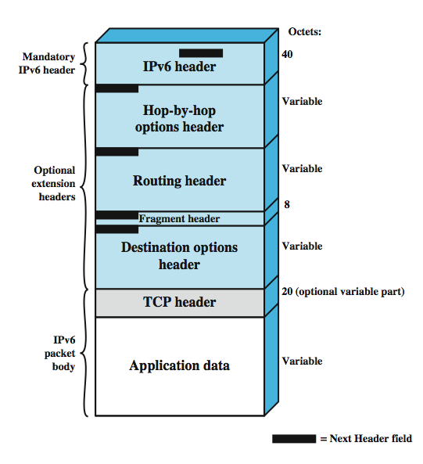
IPv6
PDU
(Packet) Structure
Notes:
An IPv6 protocol data unit (known as a packet) has the general form shown in Stallings DCC8e Figure 18.10 which includes an instance of most headers. The only header that is required is referred to simply as the IPv6 header. This is of fixed size with a length of 40 octets, compared to 20 octets for the mandatory portion of the IPv4 header (Figure 18.6). The following extension headers have been defined:
• Hop-by-Hop Options header: Defines special options that require hop-by-hop processing.
• Routing header: Provides extended routing, similar to IPv4 source routing.
• Fragment header: Contains fragmentation and reassembly information.
• Authentication header: Provides packet integrity and authentication.
• Encapsulating Security Payload header: Provides privacy.
• Destination Options header: Contains optional information to be examined by the destination node.
Note that the IPv6 header and each extension header include a Next Header field, that identifies the type of the immediately following header. If the next header is an extension header, then this field contains the type identifier of that header. Otherwise, this field contains the protocol identifier of the upper-layer protocol using IPv6 (typically a transport-level protocol), using the same values as the IPv4 Protocol field. In this figure, the upper-layer protocol is TCP; so that the upper-layer data carried by the IPv6 packet consist of a TCP header followed by a block of application data.

Slide 64
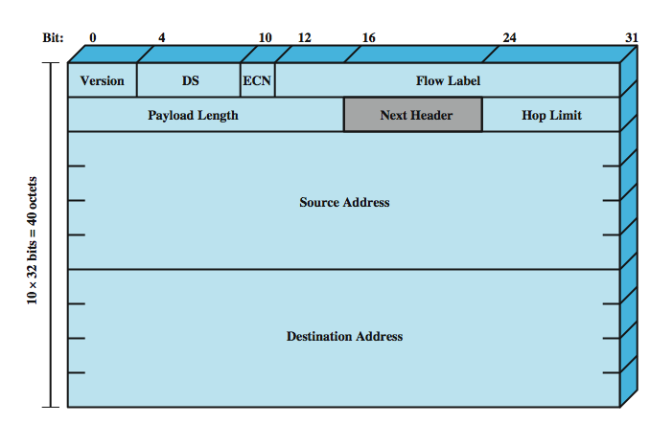
IP v6 Header
Notes:
The IPv6 header has a fixed length of 40 octets, consisting of the following fields, as shown in Stallings DCC8e Figure 18.11:
• Version (4 bits): Internet protocol version number; the value is 6.
• DS/ECN (8 bits): used by originating nodes and/or forwarding routers for differentiated services and congestion functions, see IPv4 DS/ECN field.
• Flow Label (20 bits): used by a host to label those packets for which it is requesting special handling by routers within a network.
• Payload Length (16 bits): Length of the remainder of the IPv6 packet following the header, in octets. In other words, this is the total length of all of the extension headers plus the transport-level PDU.
• Next Header (8 bits): Identifies the type of header immediately following the IPv6 header; this will either be an IPv6 extension header or a higher-layer header, such as TCP or UDP.
• Hop Limit (8 bits): The remaining number of allowable hops for this packet. The hop limit is set to some desired maximum value by the source and decremented by 1 by each node that forwards the packet. The packet is discarded if Hop Limit is decremented to zero.
• Source Address (128 bits): address of originator of the packet.
• Destination Address (128 bits): address of intended recipient of the packet.
Although the IPv6 header is longer than the mandatory portion of the IPv4 header (40 octets versus 20 octets), it contains fewer fields (8 versus 12). Thus, routers have less processing to do per header, which should speed up routing.

Slide 65
IP v6 Flow Label
related sequence of packets
needing special handling
identified by src & dest addr + flow label
router treats flow as sharing attributes
  e.g. path, resource allocation, discard requirements, accounting, security
may treat flows differently
  buffer sizes, different forwarding precedence, different quality of service
alternative to including all info in every header
have requirements on flow label processing
Notes:
RFC 3967 defines a flow as a sequence of packets sent from a particular source to a particular (unicast, anycast, or multicast) destination for which the source desires special handling by the intervening routers. A flow is uniquely identified by the combination of a source address, destination address, and a nonzero 20-bit flow label. Thus, all packets that are to be part of the same flow are assigned the same flow label by the source. A flow may comprise a single TCP connection or even multiple TCP connections. From the router's point of view, a flow is a sequence of packets that share attributes that affect how these packets are handled by the router. These include path, resource allocation, discard requirements, accounting, and security attributes. The router may treat packets from different flows differently in a number of ways, including allocating different buffer sizes, giving different precedence in terms of forwarding, and requesting different quality of service from networks.
In principle, all of a user's requirements for a particular flow could be defined in an extension header and included with each packet. The alternative, adopted for IPv6, is the flow label, in which the flow requirements are defined prior to flow commencement and a unique flow label is assigned to the flow. In this case, the router must save flow requirement information about each flow.
There are rules which must be applied to flow labels (see text).

Slide 66
IPv6 Addresses
128 bits long
assigned to interface
single interface may have multiple unicast addresses
three types of addresses:
  unicast - single interface address
  anycast - one of a set of interface addresses
  multicast - all of a set of interfaces
Notes:
IPv6 addresses are 128 bits in length. Addresses are assigned to individual interfaces on nodes, not to the nodes themselves. A single interface may have multiple unique unicast addresses. Any of the unicast addresses associated with a node's interface may be used to uniquely identify that node. The combination of long addresses and multiple addresses per interface enables improved routing efficiency over IPv4. In IPv4, addresses generally do not have a structure that assists routing, and therefore a router may need to maintain huge table of routing paths. Longer internet addresses allow for aggregating addresses by hierarchies of network, access provider, geography, corporation, and so on. IPv6 allows three types of addresses:
• Unicast: An identifier for a single interface. A packet sent to a unicast address is delivered to the interface identified by that address.
• Anycast: An identifier for a set of interfaces (typically belonging to different nodes). A packet sent to an anycast address is delivered to one of the interfaces identified by that address (the "nearest" one, according to the routing protocols' measure of distance).
• Multicast: An identifier for a set of interfaces (typically belonging to different nodes). A packet sent to a multicast address is delivered to all interfaces identified by that address.

Slide 67
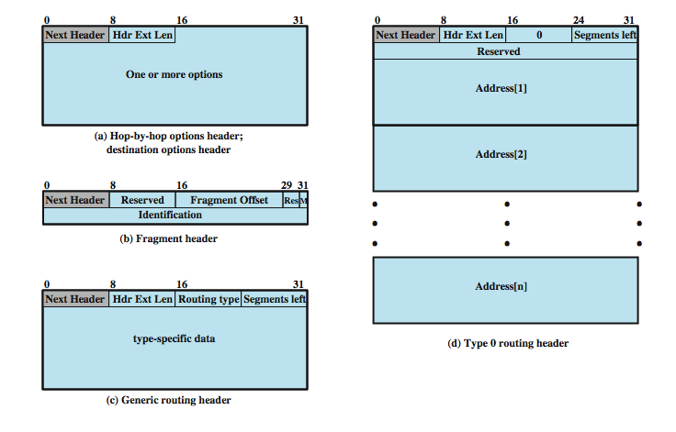
IPv6 Extension Headers
Notes:
Stallings DCC8e Figure 18.12 illustrates the various IPv6 extension headers, which we now discuss in turn.

Slide 68
Hop-by-Hop Options
must be examined by every router
  if unknown discard/forward handling is specified
next header
header extension length
options
  Pad1
  PadN
  Jumbo payload
  Router alert
Notes:
The Hop-by-Hop Options header carries optional information that, if present, must be examined by every router along the path. This header consists of (Figure 18.12a):
• Next Header (8 bits): Identifies the type of header following this header
• Header Extension Length (8 bits): Length of this header in 64-bit units, not including the first 64 bits.
• Options: A variable-length field consisting of one or more option definitions. Each definition is in the form of three subfields: Option Type (8 bits), which identifies the option; Length (8 bits), which specifies the length of the Option Data field in octets; and Option Data, which is a variable-length specification of the option. It is actually the lowest-order five bits of the Option Type field that are used to specify a particular option. The high-order two bits indicate that action to be taken by a node that does not recognize this option type (ignore, discard, discard with ICMP, discard with ICMP if not multicast). Four hop-by-hop options have been specified so far:
• Pad1: Used to insert one byte of padding into the Options area of the header.
• PadN: Used to insert N bytes (N ≥ 2) of padding into the Options area of the header. Both padding options ensure header is a multiple of 8 bytes in length.
• Jumbo payload: Used to send IPv6 packets with payloads longer than 65,535 octets.
• Router alert: Informs the router that the contents of this packet is of interest to the router and to handle any control data accordingly.

Slide 69
Fragmentation Header
fragmentation only allowed at source
no fragmentation at intermediate routers
node must perform path discovery to find smallest MTU of intermediate networks
set source fragments to match MTU
otherwise limit to 1280 octets
header includes
  fragment offset
  more fragments bit
  identification
Notes:
In IPv6, fragmentation may only be performed by source nodes, not by routers along a packet's delivery path. To take full advantage of the internetworking environment, a node must perform a path discovery algorithm that enables it to learn the smallest maximum transmission unit (MTU) supported by any network on the path. With this knowledge, the source node will fragment, as required, for each given destination address. Otherwise the source must limit all packets to 1280 octets, which is the minimum MTU that must be supported by each network. The fragmentation algorithm is the same as that described in Section 18.3. The fragment header includes (Figure 18.12b):
• Next Header (8 bits): Identifies the type of header following this header.
• Fragment Offset (13 bits): Indicates where in original packet the payload of this fragment belongs, in 64-bit units. This implies that fragments (other than the last fragment) must contain a data field that is a multiple of 64 bits long.
• M Flag (1 bit): 1 = more fragments; 0 = last fragment.
• Identification (32 bits): Intended to uniquely identify the original packet. The identifier must be unique for the packet's source address and destination address for the time during which the packet will remain in the internet. All fragments with the same identifier, source address, and destination address are reassembled to form the original packet.

Slide 70
Routing Header
list of one or more intermediate nodes to visit
header includes
  Next Header
  Header extension length
  Routing type
  Segments left
Type 0 routing provides a list of addresses
  initial destination address is first on list
  current destination address is next on list
  final destination address will be last in list
Notes:
The Routing header contains a list of one or more intermediate nodes to be visited on the way to a packet's destination. All routing headers start with a 32-bit block consisting of four 8-bit fields, followed by routing data specific to a given routing type (Figure 18.12c). The four 8-bit fields are:
• Next Header (8 bits): Identifies the type of header following this header.
• Header Extension Length: Length of this header in 64-bit units, not including the first 64 bits.
• Routing Type: Identifies a particular Routing header variant. If a router does not recognize the Routing Type value, it must discard the packet.
• Segments Left: Number of route segments remaining; that is, the number of explicitly listed intermediate nodes still to be visited before reaching the final destination.
The only specific routing header format defined in RFC 2460 is the Type 0 Routing header (Figure 18.12d). When using the Type 0 Routing header, the source node does not place the ultimate destination address in the IPv6 header. Instead, that address is the last address listed in the Routing header (Address[n] in Figure 18.12d), and the IPv6 header contains the destination address of the first desired router on the path. . The Routing header will not be examined until the packet reaches the node identified in the IPv6 header. At that point, the IPv6 and Routing header contents are updated and the packet is forwarded. The update consists of placing the next address to be visited in the IPv6 header and decrementing the Segments Left field in the Routing header.

Slide 71
Destination Options Header
carries optional info for destination node
format same as hop-by-hop header
Notes:
The Destination Options header carries optional information that, if present, is examined only by the packet's destination node. The format of this header is the same as that of the Hop-by-Hop Options header (Figure 18.12a).

Slide 72
Virtual Private Networks
set of computers interconnected using an insecure network
  e.g. linking corporate LANs over Internet
using encryption & special protocols to provide security
  to stop eavesdropping & unauthorized users
proprietary solutions are problematical
hence development of IPSec standard
Notes:
A virtual private network (VPN) consists of a set of computers that interconnect by means of a relatively unsecure network and that make use of encryption and special protocols to provide security. At each corporate site, workstations, servers, and databases are linked by one or more local area networks (LANs). The LANs are under the control of the network manager and can be configured and tuned for cost-effective performance. The Internet or some other public network can be used to interconnect sites, providing a cost savings over the use of a private network and offloading the wide area network management task to the public network provider. That same public network provides an access path for telecommuters and other mobile employees to log on to corporate systems from remote sites.
Have a fundamental requirement: security. Use of a public network exposes corporate traffic to eavesdropping and provides an entry point for unauthorized users. To counter this problem, the manager may choose from a variety of encryption and authentication packages and products. Proprietary solutions raise a number of problems. First, how secure is the solution? If proprietary encryption or authentication schemes are used, there may be little reassurance in the technical literature as to the level of security provided. Second is the question of compatibility. No manager wants to be limited in the choice of workstations, servers, routers, firewalls, and so on by a need for compatibility with the security facility. This is the motivation for the IP Security (IPSec) set of Internet standards.

Slide 73
IPSec
RFC 1636 (1994) identified security need
encryption & authentication to be IPv6
but designed also for use with current IPv4
applications needing security include:
  branch office connectivity
  remote access over Internet
  extranet & intranet connectivity for partners
  electronic commerce security
Notes:
In 1994, the Internet Architecture Board (IAB) issued a report titled "Security in the Internet Architecture" (RFC 1636). The report stated the general consensus that the Internet needs more and better security, and identified key areas for security mechanisms. To provide security, the IAB included authentication and encryption as necessary security features in the next-generation IP, which has been issued as IPv6. These security capabilities were designed to be usable both with the current IPv4 and the future IPv6. IPSec provides the capability to secure communications across a LAN, across private and public WANs, and across the Internet. Examples of its use include:
• Secure branch office connectivity over the Internet: A company can build a secure virtual private network over the Internet or over a public WAN.
• Secure remote access over the Internet: An end user whose system is equipped with IP security protocols can make a local call to an Internet service provider (ISP) and gain secure access to a company network.
• Establishing extranet and intranet connectivity with partners: IPSec can be used to secure communication with other organizations, ensuring authentication and confidentiality and providing a key exchange mechanism.
• Enhancing electronic commerce security: Even though some Web and electronic commerce applications have built-in security protocols, the use of IPSec enhances that security. IPSec guarantees that all traffic designated by the network administrator is both encrypted and authenticated, adding an additional layer of security to whatever is provided at the application layer.

Slide 74
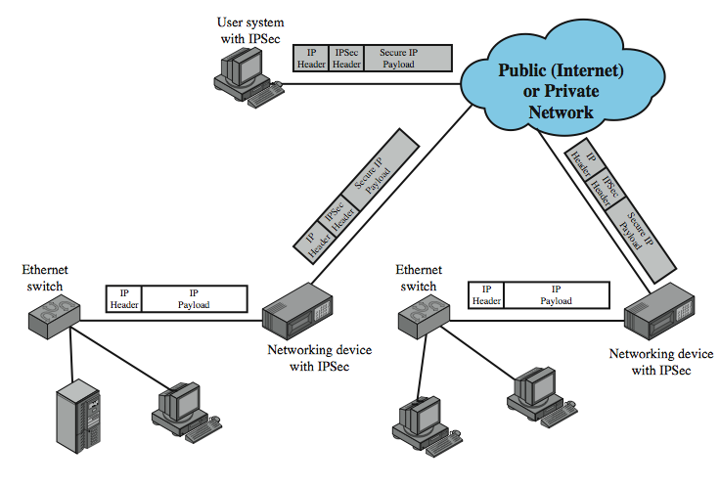
IPSec Scenario
Notes:
The principal feature of IPSec that enables it to support these varied applications is that it can encrypt and/or authenticate all traffic at the IP level. Thus, all distributed applications, including remote logon, client/server, e-mail, file transfer, Web access, and so on, can be secured.
Stallings DCC8e Figure 18.13 is a typical scenario of IPSec usage. An organization maintains LANs at dispersed locations. Nonsecure IP traffic is conducted on each LAN. For traffic offsite, through some sort of private or public WAN, IPSec protocols are used. These protocols operate in networking devices, such as a router or firewall, that connect each LAN to the outside world. The IPSec networking device will typically encrypt and compress all traffic going into the WAN, and decrypt and decompress traffic coming from the WAN; these operations are transparent to workstations and servers on the LAN. Secure transmission is also possible with individual users who dial into the WAN. Such user workstations must implement the IPSec protocols to provide security.

Slide 75
IPSec Benefits
provides strong security for external traffic
resistant to bypass
below transport layer hence transparent to applications
can be transparent to end users
can provide security for individual users if needed
Notes:
Some of the benefits of IPSec:
• When IPSec is implemented in a firewall or router, it provides strong security that can be applied to all traffic crossing the perimeter. Traffic within a company or workgroup does not incur the overhead of security-related processing.
• IPSec in a firewall is resistant to bypass if all traffic from the outside must use IP and the firewall is the only means of entrance from the Internet into the organization.
• IPSec is below the transport layer (TCP, UDP) and so is transparent to applications. There is no need to change software on a user or server system when IPSec is implemented in the firewall or router. Even if IPSec is implemented in end systems, upper-layer software, including applications, is not affected.
• IPSec can be transparent to end users. There is no need to train users on security mechanisms, issue keying material on a per-user basis, or revoke keying material when users leave the organization.
• IPSec can provide security for individual users if needed. This is useful for offsite workers and for setting up a secure virtual subnetwork within an organization for sensitive applications.

Slide 76
IPSec Functions
Authentication Header
  for authentication only
Encapsulating Security Payload (ESP)
  for combined authentication/encryption
a key exchange function
  manual or automated
VPNs usually need combined function
see chapter 21
Notes:
IPSec provides three main facilities: an authentication-only function referred to as Authentication Header (AH), a combined authentication/encryption function called Encapsulating Security Payload (ESP), and a key exchange function. For VPNs, both authentication and encryption are generally desired, because it is important both to (1) assure that unauthorized users do not penetrate the virtual private network and (2) assure that eavesdroppers on the Internet cannot read messages sent over the virtual private network. Because both features are generally desirable, most implementations are likely to use ESP rather than AH. The key exchange function allows for manual exchange of keys as well as an automated scheme. IPSec is explored in Chapter 21.

Slide 77
Summary
basic protocol functions
internetworking principles
connectionless internetworking
IP
IPv6
IPSec
Notes:
Chapter18 summary.

